Slide 1
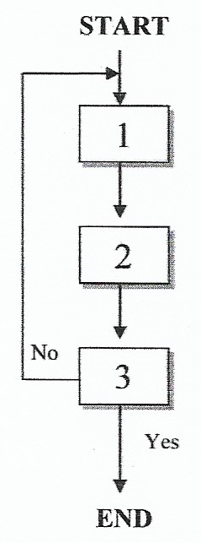
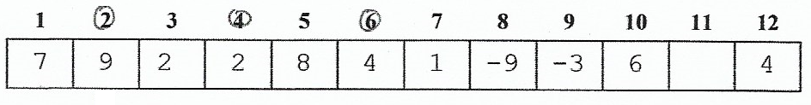
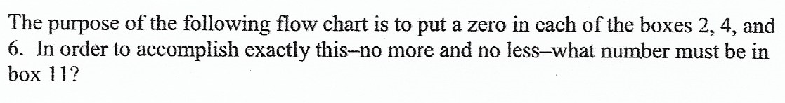
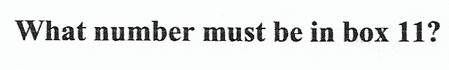

Slide 2
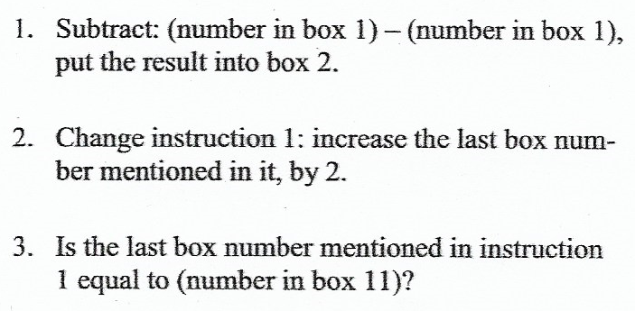

Slide 3
0

Slide 4
0

Slide 5
0
4

Slide 6
0
4

Slide 7
0
4
Because The Number in The Box Number 4 and 6 is not 0 yet, the flow have to continue

Slide 8
0
Not 4
4
Because The Number in The Box Number 4 and 6 is not 0 yet, the flow have to continue

Slide 9
0
Not 4
4

Slide 10
0
0
Not 4
4

Slide 11
0
0
Not 4
4

Slide 12
0
0
Not 4
6

Slide 13
0
0
Not 4
6

Slide 14
0
0
Not 4
6
Because The Number in The Box Number 6 is not 0 yet, the flow have to continue

Slide 15
0
0
Not 4
Not 6
6
Because The Number in The Box Number 6 is not 0 yet, the flow have to continue

Slide 16
0
0
Not 4
Not 6
6

Slide 17
0
0
0
Not 4
Not 6
6

Slide 18
0
0
0
Not 4
Not 6
6

Slide 19
0
0
0
Not 4
Not 6
8

Slide 20
0
0
0
Not 4
Not 6
8
The condition is already fulfilled in this stage. So to quit the loop, statement number 3 have to be true

Slide 21
0
0
0
8
Not 4
Not 6
8
The condition is already fulfilled in this stage. So to quit the loop, statement number 3 have to be true

Slide 22
0
0
0
8
Not 4
Not 6
8

